Slide 1

VIRS 3.0
Team Members: Juan Carlos Valladares, Christian Hidalgo Product Owner: Eric Dwyer
Instructor: Masoud Sadjadi School of Computing and Information Sciences Florida International University
Final Presentation
Spring 2018
Notes:
7 seconds.( I will select 2 best slides (i will give them extra points and students will present for CIS committee)
Greet your audience, thank them for attending your presentation, introduce yourself, introduce your project, introduce your team members, and quickly indicate what each of you did in a high-level manner, and put more emphasis on your part/contribution.

Slide 2
Project definition
One of the major challenges that English Language learners (ELL) as well as mainstream students face is the lack of a reliable source to improve their academic words.
Notes:
10 seconds.
Introduce the problem that the whole project (in all versions) tackles with GIF or screenshot.

Slide 3
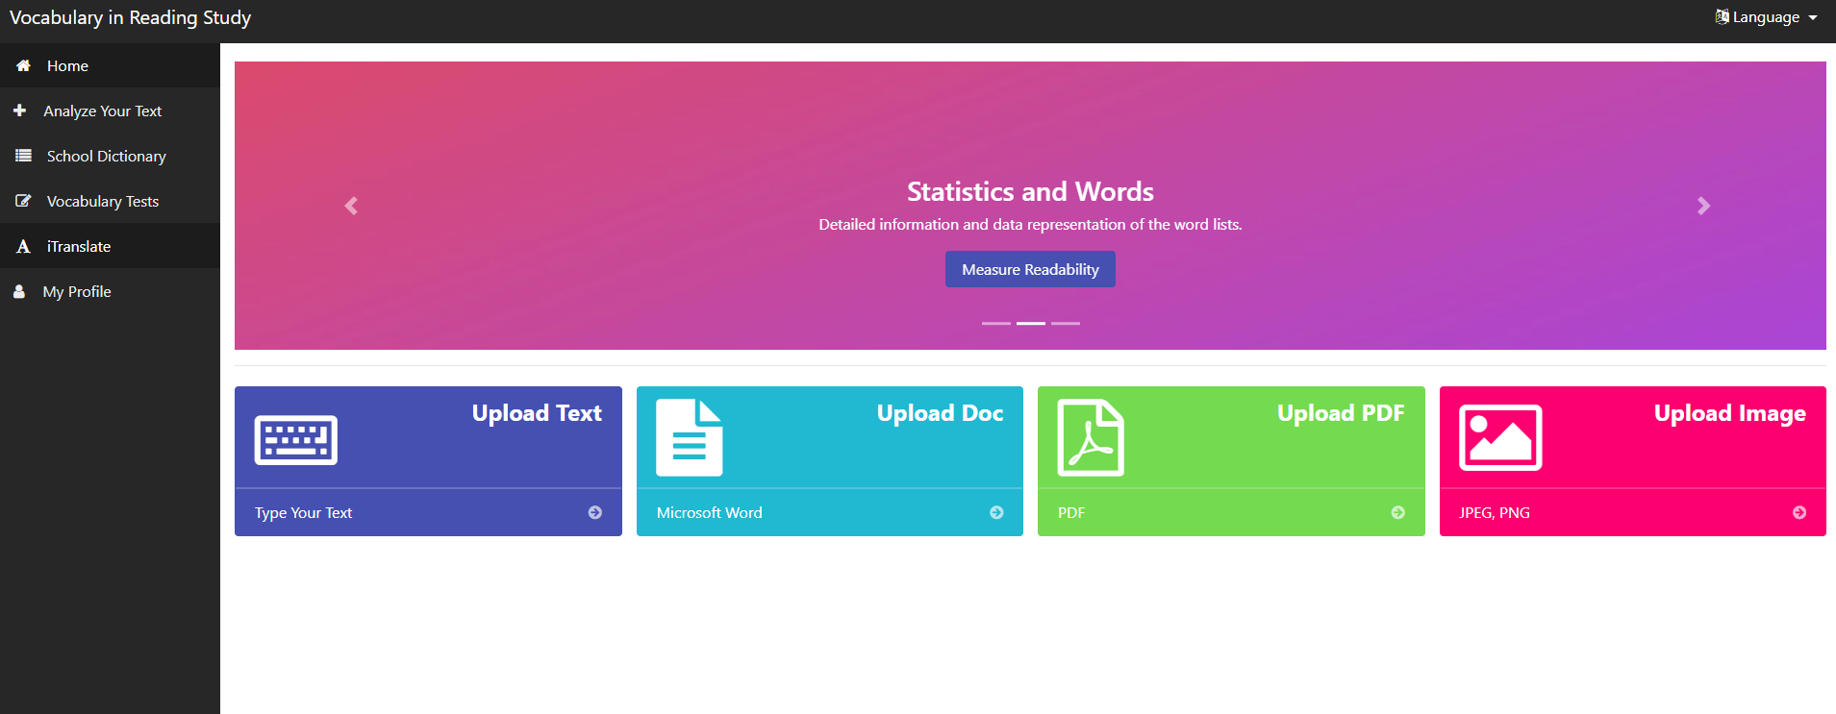
Project definition
Screenshots or GIF pictures of the new version
Notes:
20 seconds.
Introduce the problem that the your project (in new version) tackles with GIF or screenshot.

Slide 4
Requirements: Use Cases
•Application can translate users text to desired language
•Administrator has to be able to add multiple words to database
•Application has to display new added words
Notes:
5 seconds
Show the Use Case Diagram for the whole project. Highlight your use cases.

Slide 5
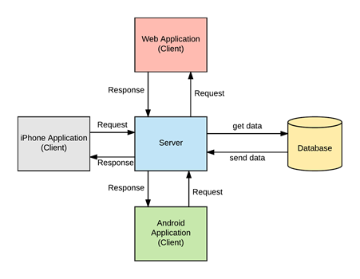
System Design: Architecture
Model-View-Controller
Notes:
20 seconds
System design: Highlight the parts that you contributed to them.
1. System decomposition; identify the architecture patterns used
2. System deployment – h/w and s/w requirements

Slide 6
User Stories
1. User Story: [#264] [Frontend] Translator
2. User Story: [#276] [Backend] Translation Endpoint to connect with Frontend
3. User Story: [#277] Add multiple words through dictionary to CSV
4. User Story: [#283] Itranslate limitations for different users
5. User Story: [#288] [Frontend] - Paypal Donate Button
Notes:
5 seconds.
List the user stories that you worked on them.(put in order of importance). Stay focused on the parts that you have been working.

Slide 7
User Story #1
[Frontend] Translator
Description: As a User I would like to input text so that the text can be translated to selected language
Acceptance Criteria
Text can be inputted and target language can be selected
Translated text can be displayed
Use Case
Name: Translate text
Actor: User
Preconditions: User must be in the itranslate page of the site
Description :
System displays text area for user to input text and allows user to select target language
System then displays translated text
Notes:
60 seconds
The tile of user story
The most important user story you worked on it. You have to describe this one very well and be proud of that.
Please present and show the complexity of your work, code, algorithms, and technical challenges and technologies you have used. (you could use screenshot if you want. Visual presentations are better than text presentation)
Go into the details of the most important/significant tasks using bullet lists or visual graphs or state chart diagram
Sequence Diagram for this user story is mandatory (in another separate page if required)
Demo using screenshots or GIF (in another separate page if required)

Slide 8
User Story #2
[Backend] iTranslator endpoint
Description: As a Frontend I would like to send requests to the backend so that I can have the backend translate words
Acceptance Criteria
The backend returns a json that includes the translation
Use Case
Name: Itranslate_Backend
Actor: Frontend
Preconditions: Frontend is able to send requests to backend
Description :
Frontend sends post request to backend
Backend takes request and prompts google for translation
Backend receives translation from google
Backend sends json with translation to frontend
Notes:
20 seconds
The tile of user story
Please present and show the complexity of your work, code, algorithms, and technical challenges and technologies you have used. (you could use screenshot if you want. Visual presentations are better than text presentation) - Go into the details of the most important/significant tasks using bullet lists or visual graphs or state chart diagram - Demo using screenshots or GIF (in another separate page if required)
Sequence Diagram for this user story is optional

Slide 9
User Story #3
Add multiple words
Description: As an administrator I would like to be able to upload a csv so that I can add multiple words to database at once
Acceptance Criteria
Words from csv are added to database
Use Case
Name: Add_Multiple_Words
Actor: Administrator
Preconditions: Administrator has logged in to admin portal and has a csv file ready to upload with content
Description :
Admin uploads csv
System processes csv
System adds words to database
System displays to user words that were added.
Notes:
20 seconds
The tile of user story
Please present and show the complexity of your work, code, algorithms, and technical challenges and technologies you have used. (you could use screenshot if you want. Visual presentations are better than text presentation) - Go into the details of the most important/significant tasks using bullet lists or visual graphs or state chart diagram - Demo using screenshots or GIF (in another separate page if required)
Sequence Diagram for this user story is optional

Slide 10
User Story #4
User Story Name: Itranslate Limit
Description: As a User I would like to know the limits of characters I can translate so that I know how much left I can translate
Acceptance Criteria
User can see how many characters they have left to translate
User can’t translate any more characters once they’ve reached zero
Use Case
Name: Translation_Limit_001
Actor: User
Preconditions: User must be in translation page
Description :
User translates
Counter with Characters left to translate updates
User can’t translate once they reach 0 characters
Notes:
20 seconds
The tile of user story
Please present and show the complexity of your work, code, algorithms, and technical challenges and technologies you have used. (you could use screenshot if you want. Visual presentations are better than text presentation) - Go into the details of the most important/significant tasks using bullet lists or visual graphs or state chart diagram - Demo using screenshots or GIF (in another separate page if required)
Sequence Diagram for this user story is optional

Slide 11
User Story #5
User Story Name: Paypal Donate Button
Description: As a User I would like to be able to click a donate button so that I can donate money to support the website.
Acceptance Criteria
A user can click a donate button and they can enter an amount for donation.
Money donated is in paypal account
Use Case
Name: Paypal_Donate_Button
Actor: User
Preconditions: Be on the site
Description :
User clicks on donate button
User goes through paypal donation process
User is returned to site with confirmation
Notes:
20 seconds
The tile of user story
Please present and show the complexity of your work, code, algorithms, and technical challenges and technologies you have used. (you could use screenshot if you want. Visual presentations are better than text presentation) - Go into the details of the most important/significant tasks using bullet lists or visual graphs or state chart diagram - Demo using screenshots or GIF (in another separate page if required)
Sequence Diagram for this user story is optional

Slide 12
Test Suites and Test Cases
Test case ID: iTranslator_Hello_toSpanish_001
Test case ID: Itranslator_request_001
Test case ID: Add_words_multiple_categories001
Test case ID: Translation_Limit_001
Test case ID: Paypal_Donate_001
Notes:
10 seconds
A description of verification process and Test Suites and Test Cases for one of the use cases.
1 One sunny day and one rainy day for the implemented use cases (one or more slides).
2 Automated test scripts for the implemented use cases (if any) (one or more slides).

Slide 13
Summary
Summary
VIRS is a web app which facilitates learning of new languages through analysis of text and gathering of data which is then displayed to the user. Data given to the user includes category of word as far as popularity and definition of the words in the text with respect to the information in the database. It also provides the user with a complete statistical text analysis report and readability score. The application now allows translation, user registration, testing and new administrative tools for the database management.
contact information: jvall013@fiu.edu
Questions?
Thank You!
Notes:
10 seconds
Summarize your contribution, mention your effort for Scrum, Mingle, Github, Google Drive Documentation and minutes
Include your contact information
Ask if anyone has any questions for you.
Thank your audience

